Slide 1
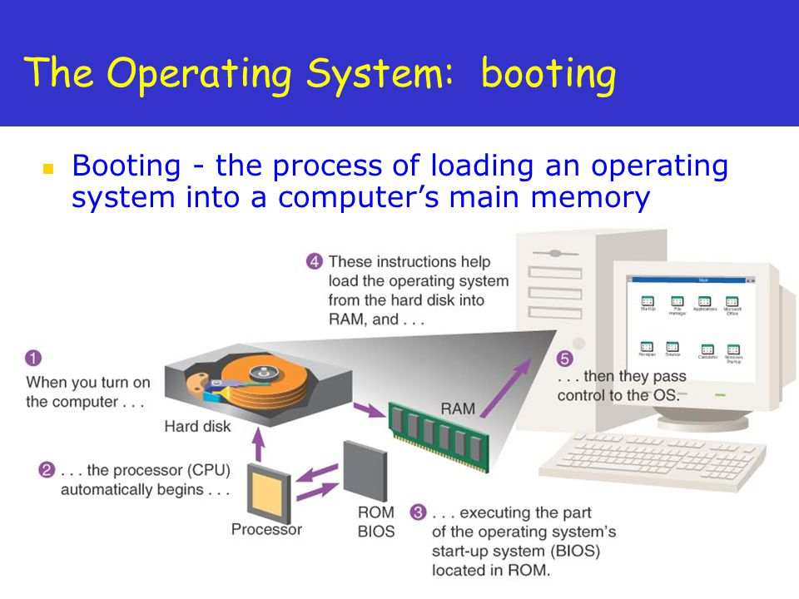
BOOTING PROCESS
Booting is a startup sequence that starts the operating system of a computer when it is turned on.
There are two Types of Booting
Warm Booting
Cold Booting

Slide 2
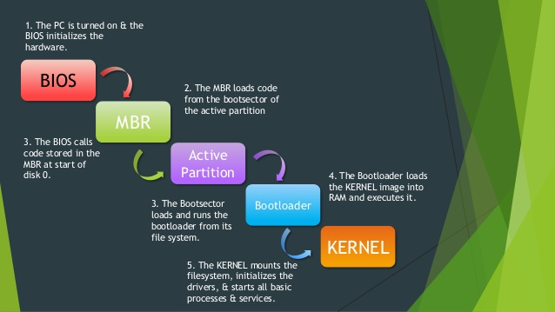
BIOS INITIALIZATION
EEPROM containing the BIOS.
The tasks performed by BIOS are categorized as follows.
POST - Power on Self Test
MBR - Master Boot Record

Slide 3
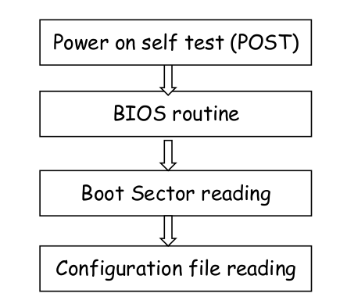
POST - Power on Self Test
Power on Self Test is the foremost routine which checks and tests the basic hardware. If it fails then it displays error.
Initialization of the hardware devices by letting them run their individual BIOS.
Searching for the Master Boot Record and reading it.
Copying the boot sector code to RAM and then switching the control to it.

Slide 4
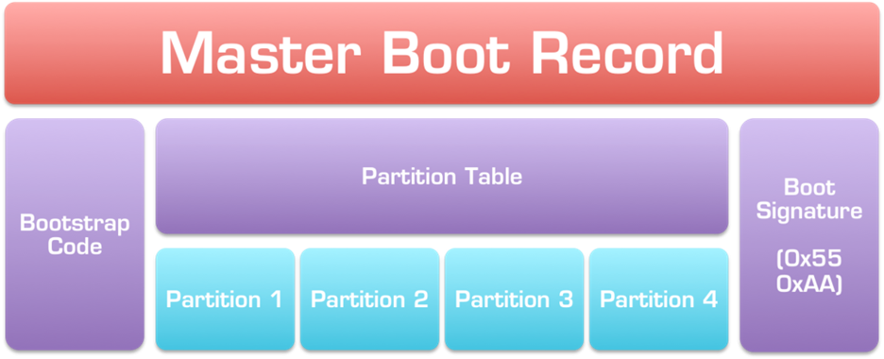
MBR - Master Boot Record
The Master Boot Record (MBR) is the information in the first sector of any hard disk or diskette that identifies how and where an operating system is located so that it can be boot (loaded) into the computer's main storage or random access memory.

Slide 5
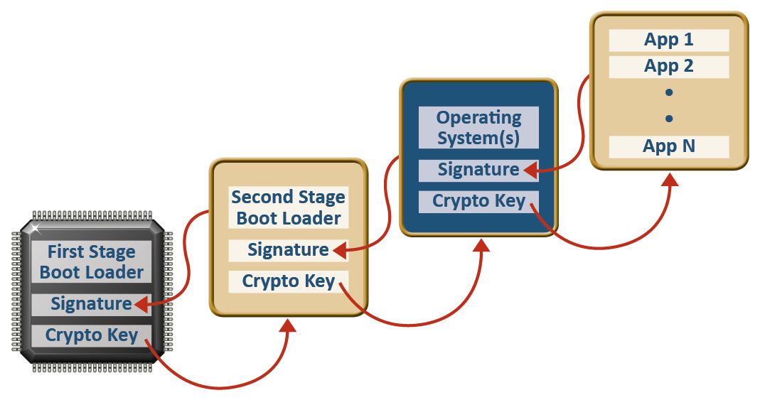
Boot Loader
A boot loader is a computer program that loads an operating system or some other system software for the computer after completion of the power-on self-tests; it is the loader for the operating system itself. Within the hard reboot process, it runs after completion of the self-tests, then loads and runs the software.

Slide 6
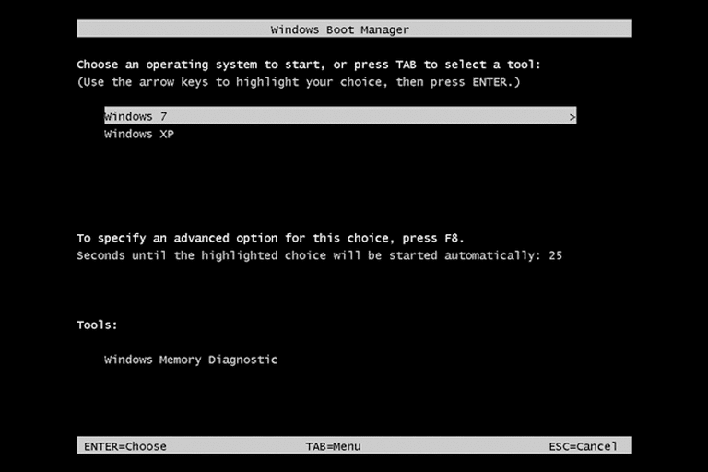
Windows Boot Manager
Windows Boot Manager (BOOTMGR) is a small piece of software, called a boot manager, that's loaded from the volume boot code, which is part of the volume boot record.
BOOTMGR helps your Windows 10, Windows 8, Windows 7, or Windows Vista operating system start.
BOOTMGR eventually executes winload.exe, the system loader used to continue the Windows boot process.

Slide 7
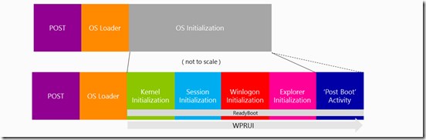
Operating System Initialization
The operating system or an application program is first loaded into memory, a part of the program performs initialization - that is, it looks in the initialization files, finds definite values to substitute for variable values, and acts accordingly.

Slide 8
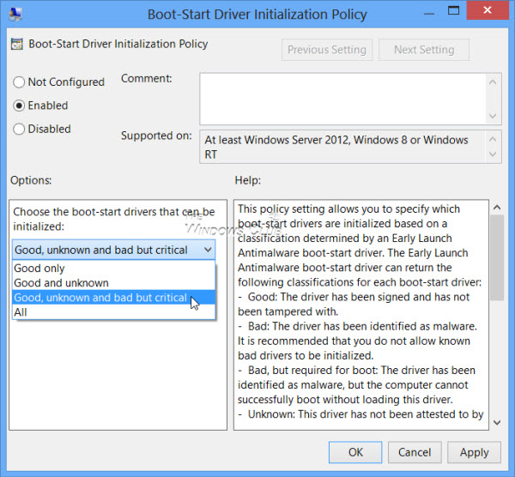
Boot-Start Driver
A boot-start driver is a driver for a device that must be installed to start the Microsoft Windows operating system. Most boot-start drivers are included "in-the-box" with Windows, and Windows automatically installs these boot-start drivers during the text-mode setup phase of Windows installation. If a boot-start driver for a device is not included "in-the-box" with Windows, a user can install an additional vendor-supplied boot-start driver for the device during text-mode setup

